Slide 1

Music Cities Together
Covid-19 Impact Survey
* North Carolina
C o l t o n D o w l i n g
· A l e x S i m o n ·
M e g g a n L a n p h e r

Slide 2
Questions Being Asked
What’s the breakdown of occupations and employment statuses?
What’s the breakdown of employment statuses specifically for Music Creatives and Presenters/Venues? (the top two occupations)
There were only 12 Presenters/Venues for NC, so we can’t really produce any meaningful insights and broad trends for this occupation.
How much income/economic loss do people estimate they’re going to face in 2020?
How are musicians and venues intending to pursue assistance funds?
How confident are they in actually receiving these funds?
What are the largest barriers to obtaining funds?
How do people feel about a variety of resources and policies to help them through this pandemic?

Slide 3
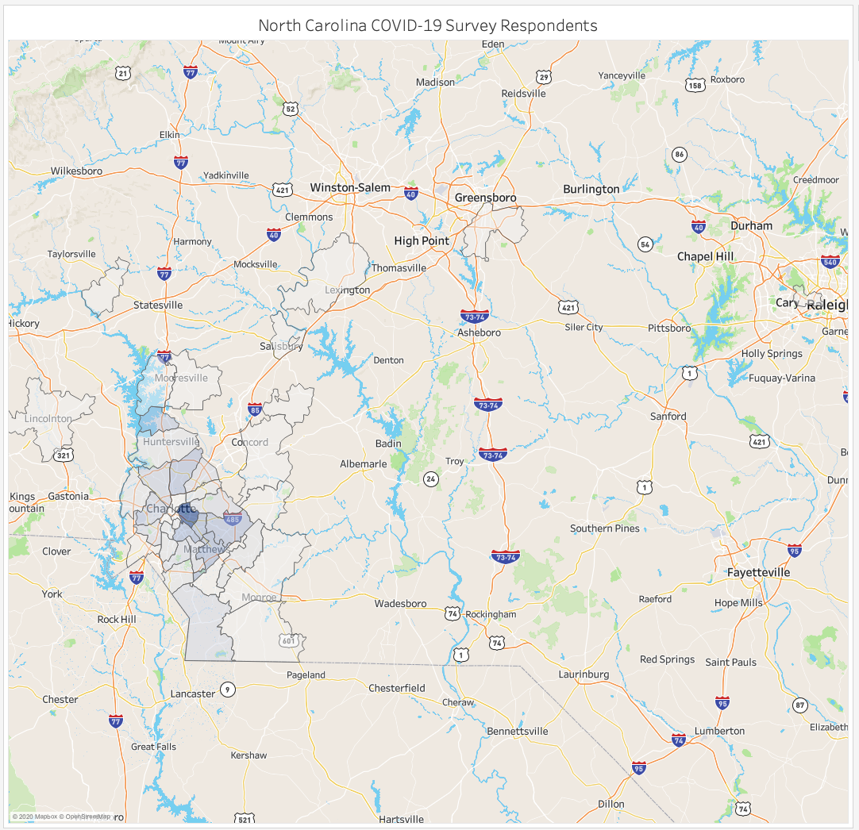
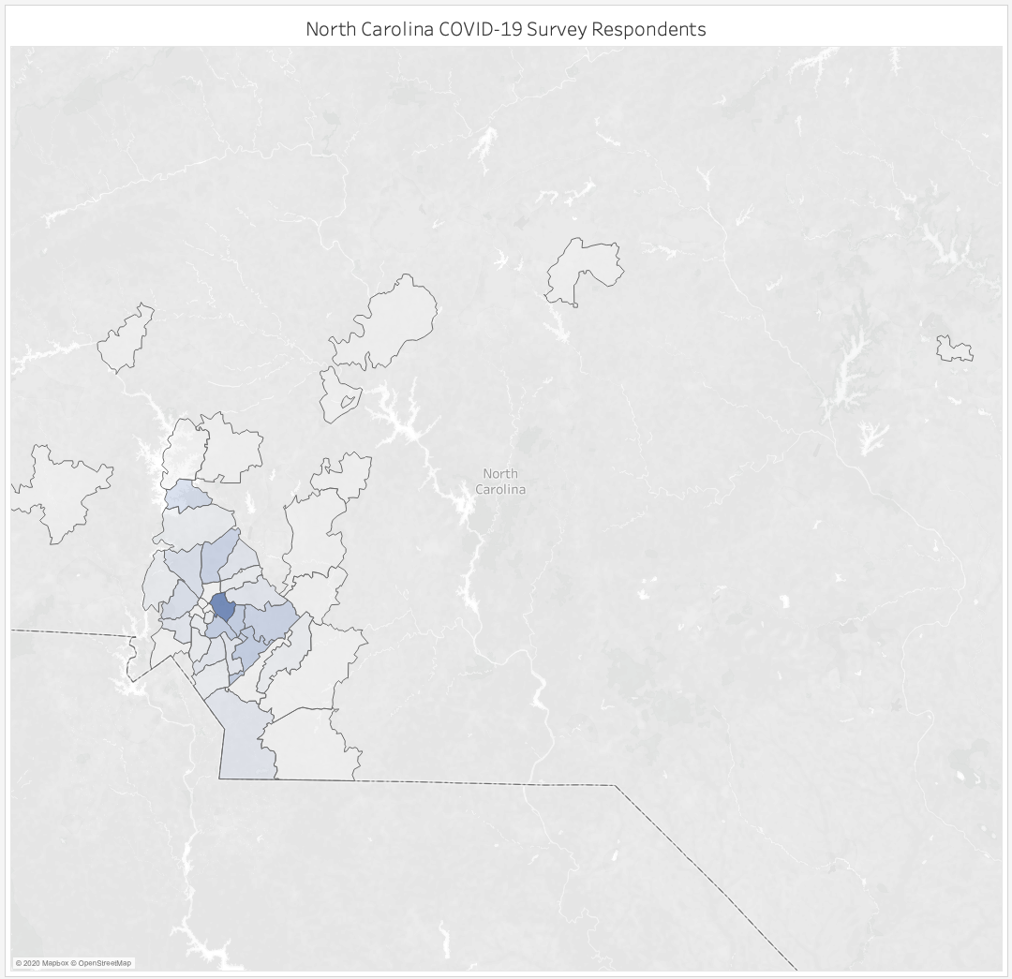
Notes:
Concentration of Respondents from North Carolina by Zip Code

Slide 4
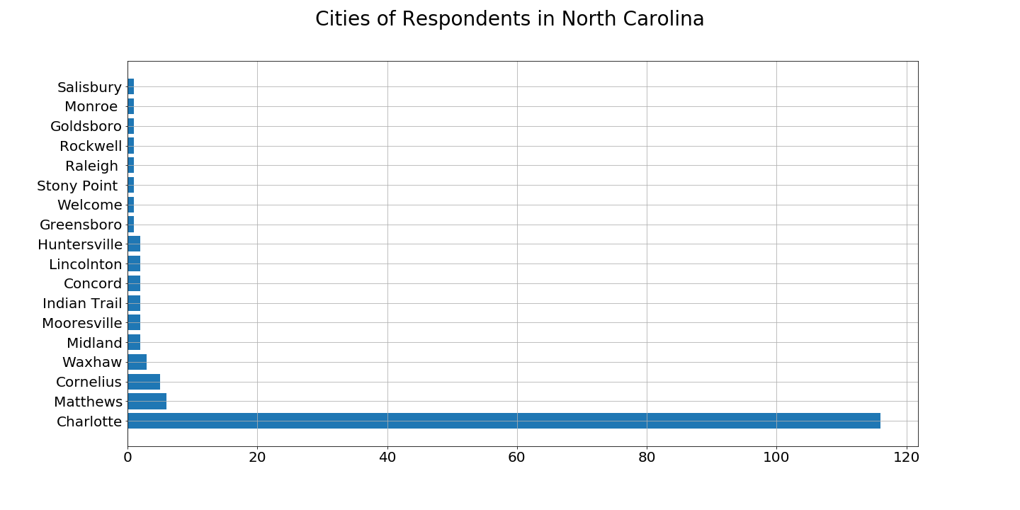
1
150 respondents in North Carolina
2
3
5
6
116

Slide 5
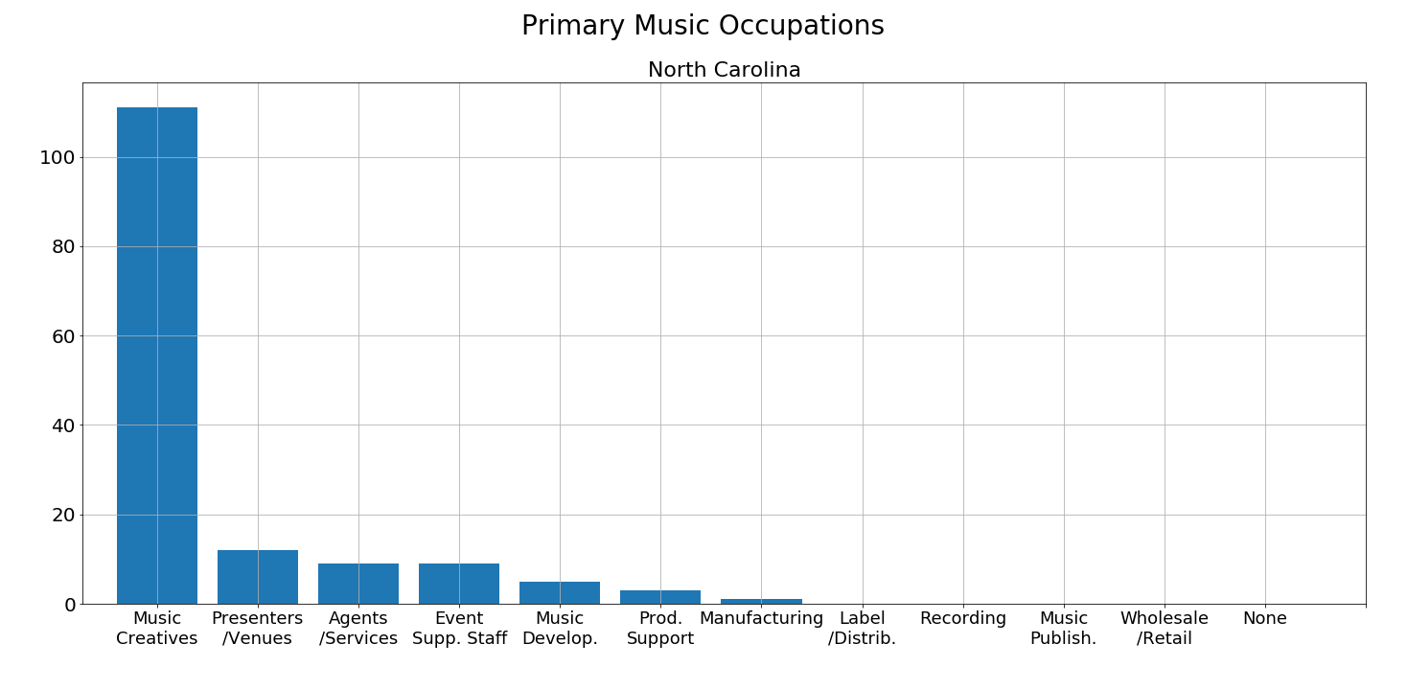
111
150 survey respondents in North Carolina
12
9
9
5
3
1
Notes:
It’s as you would expect. The breakdown is roughly similar to Austin’s and the rest of the country.

Slide 6
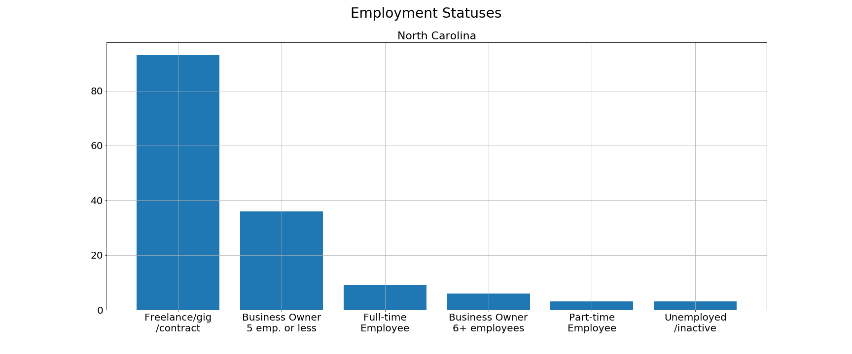
93
150 survey respondents in North Carolina
36
9
6
3
3
Notes:
In NC there were a few more 6+ business owners who responded than part-time employees, which is backwards from Austin, but we’re talking about a difference of 3 people, so it’s not really worthwhile.

Slide 7
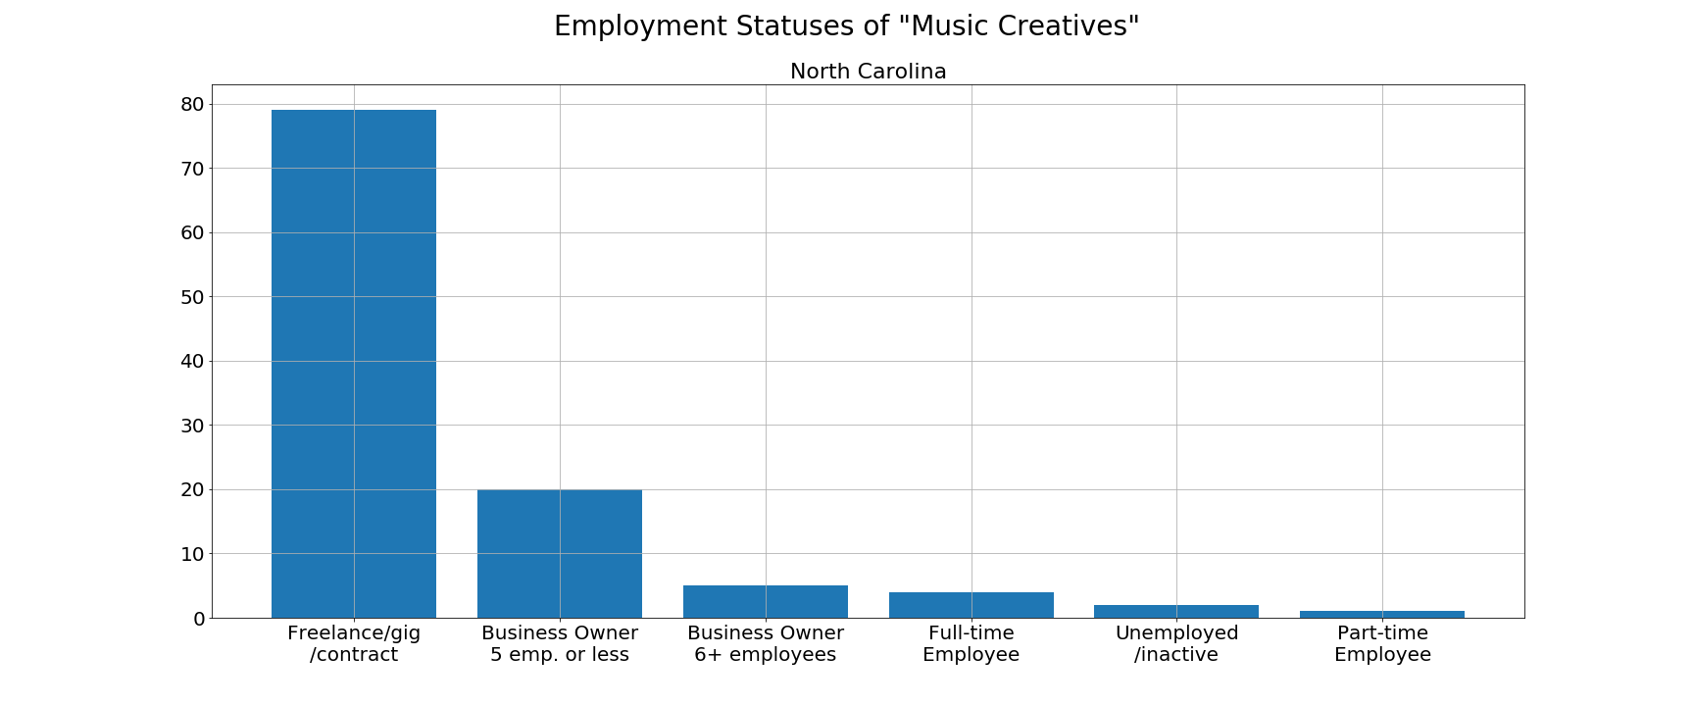
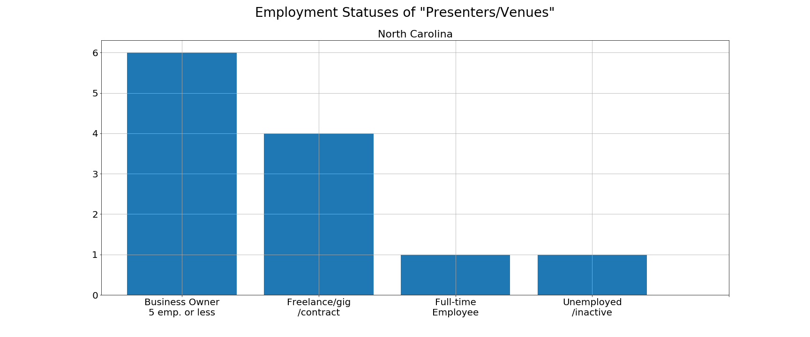
As you can see in the top chart, 79 of 111 “Music Creatives” in North Carolina identified themselves as freelancers and gig/contract workers. The second largest employment status was business owners (with 5 employees or less) who comprised 20 out of 111 people.
In the bottom chart is the breakdown of employment status for those in the “Presenters/Venues” occupation. Unfortunately, with only 12 respondents in the survey in this category, we can’t make any meaningful insights or observe broad trends. You can see the employment statuses of those 12 people though on the right.
79
111 “Music Creatives” in North Carolina
20
5
4
2
1
6
12 “Presenters/Venues” in North Carolina
4
1
1

Slide 8
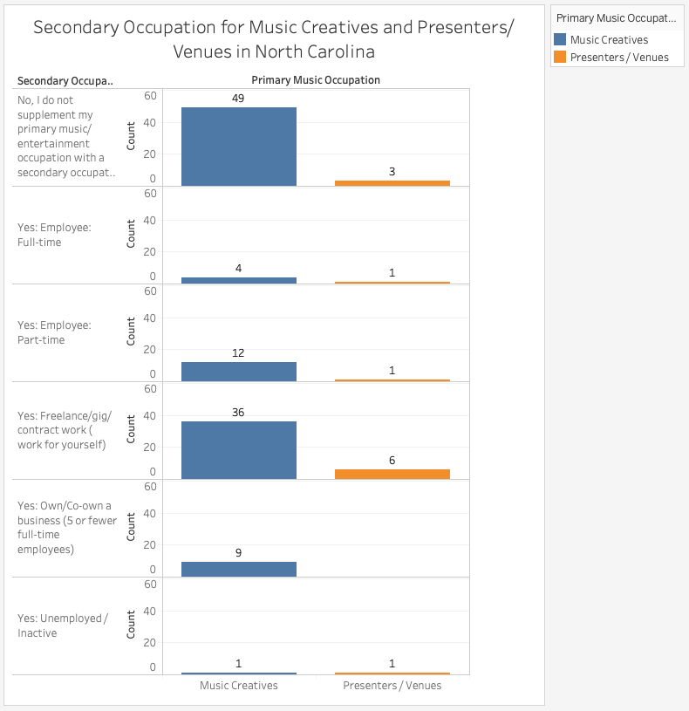
~58% of Music Creatives and Presenters/Venues in North Carolina have a Secondary Occupation in the Music Industry
~60% of Secondary Occupations for Music Creatives and Presenters/Venues is Freelance/gig/contract work

Slide 9
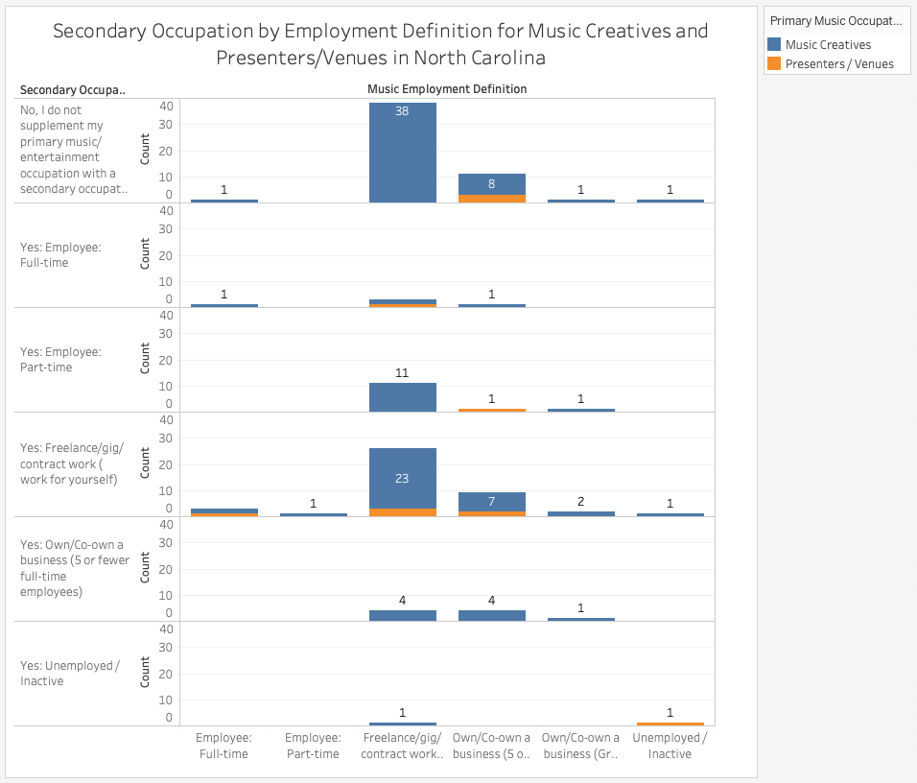

Slide 10
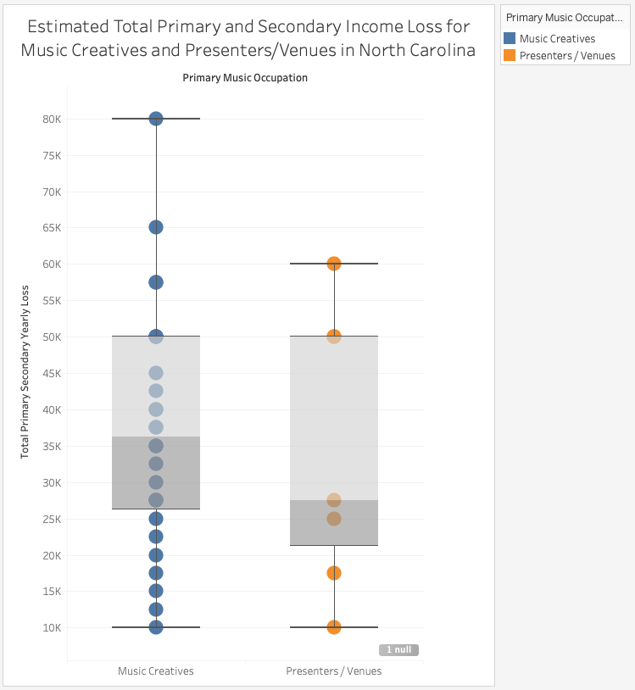
Estimated yearly loss for:
Combined Primary and Secondary Occupations
Mean = ~ $ 29,700
Median = $ 27,500
Mode = $ 20,000
* The totals were calculated from buckets of projected losses and with a constraint of up to $10,001 per occupation per quarter

Slide 11
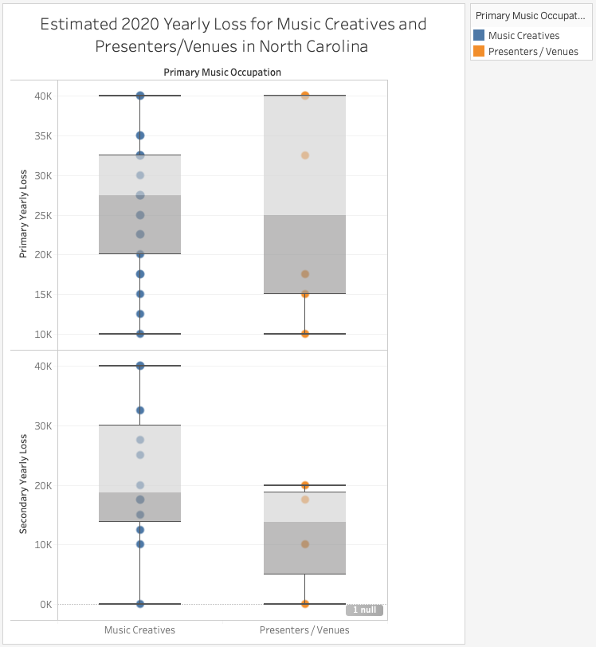
Estimated yearly loss for:
Primary Income
Mean = ~ $ 18,600
Median = $ 17,500
Mode = $ 10,000
Secondary Income
Mean = ~ $ 11,000
Median = $ 10,000
Mode = $ 10,000

Slide 12
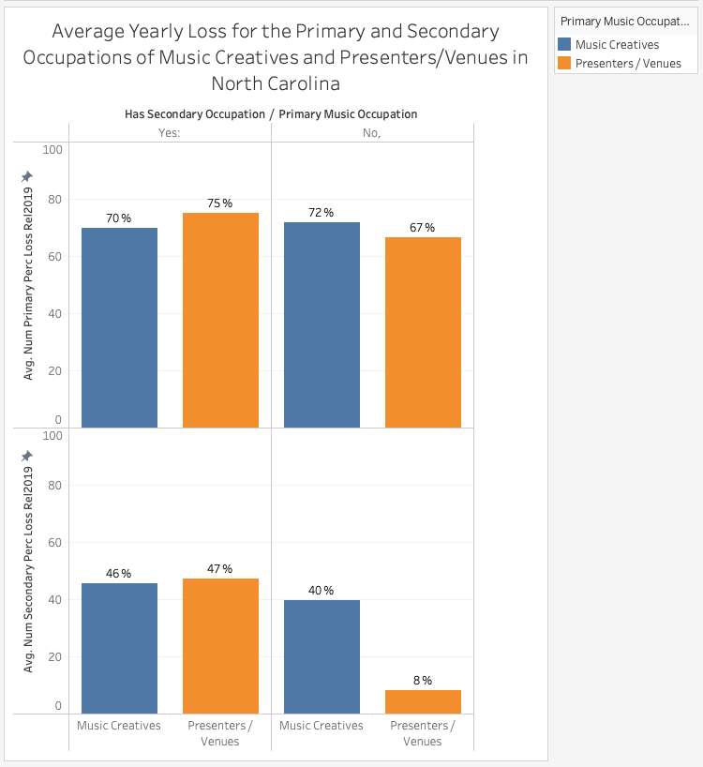
Survey respondents that identified as not having a secondary occupation in the music industry still claimed income loss for a secondary occupation in the form. Obviously that doesn’t make sense.
We speculate it could be because these respondents have a secondary source of income outside the industry (think of part-time Lyft/Uber drivers, restaurant servers, etc.)

Slide 13
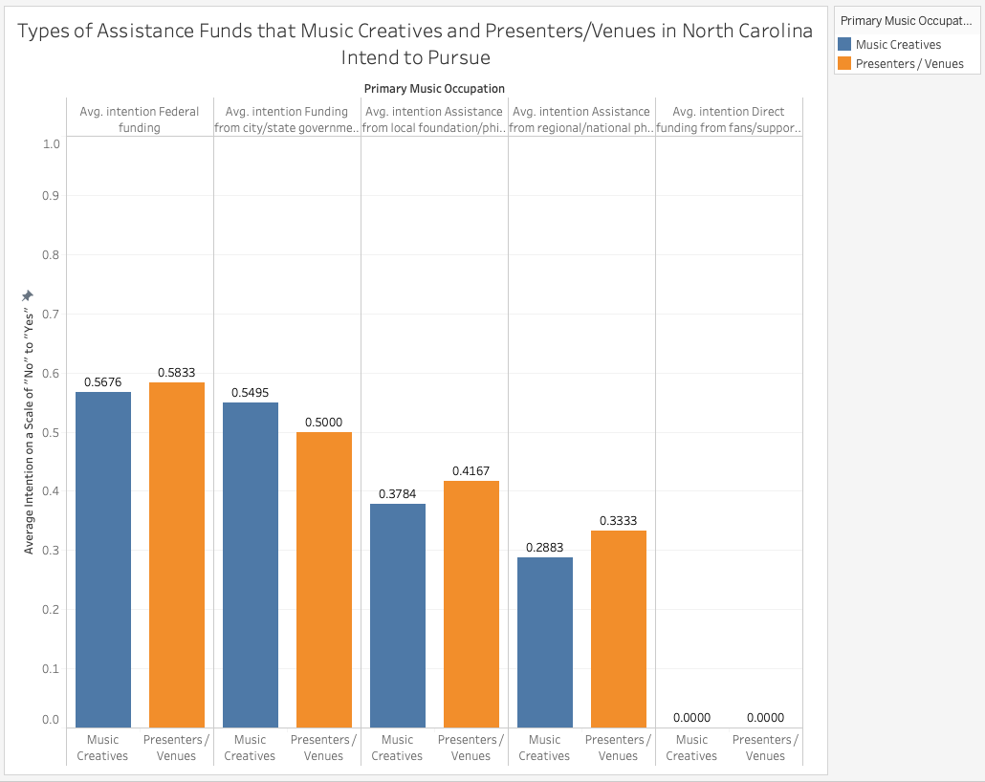
57 % intend to pursue Federal Funding
54 % also intend to pursue City/State Government Funding
38 % intend to pursue assistance from a Local Foundation/Philanthropy
29 % intend to pursue assistance from a Regional/National Philanthropy
0% intend to pursue funding from fans/supporters

Slide 14
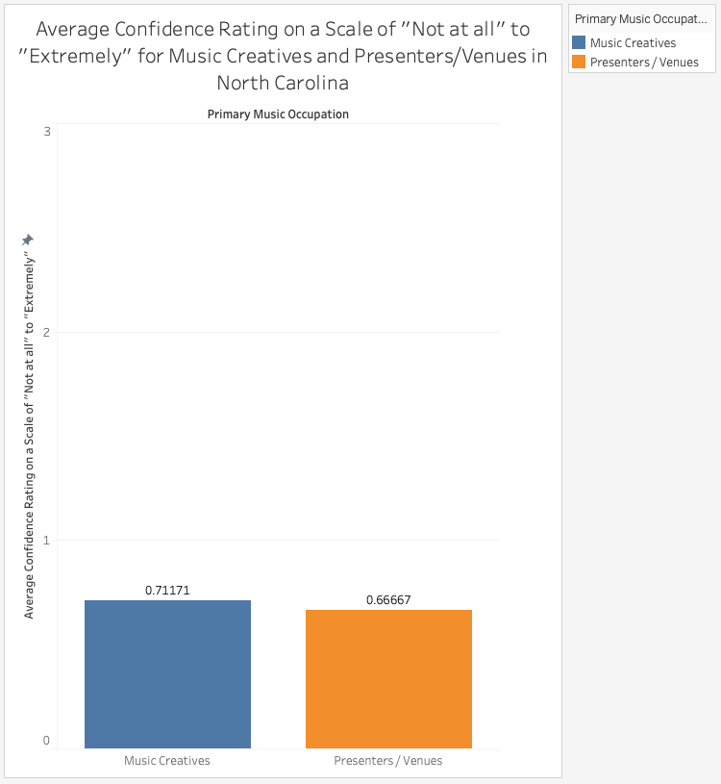
3 = “Extremely”
2 = “Very”
1 = “Somewhat”
0 = “Not at all”
On average, Music Creatives and Presenters/Venues are between “Not at all” and “Somewhat” confident that they will receive funding from the government or charities.

Slide 15
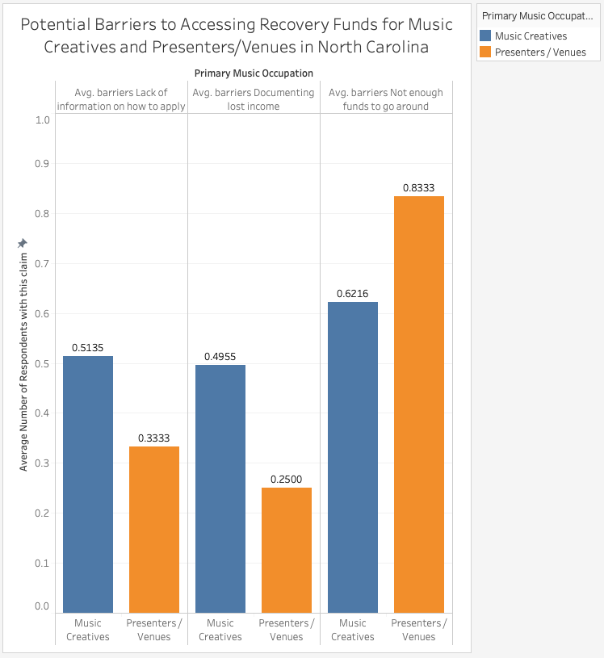
~50 % claim that a Lack of Information is a barrier to funds
~47 % claim that Documenting Lost Income is a barrier to funds
~64 % claim that Not Enough Funds to Go Around is a barrier to funds
* In the “Other” column, most of the responses written in were that the person was not intending to apply for funding.

Slide 16
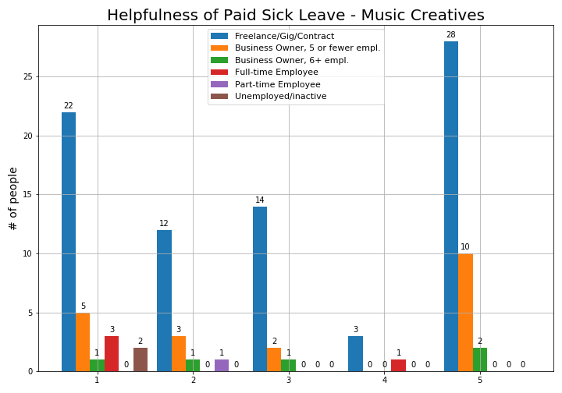
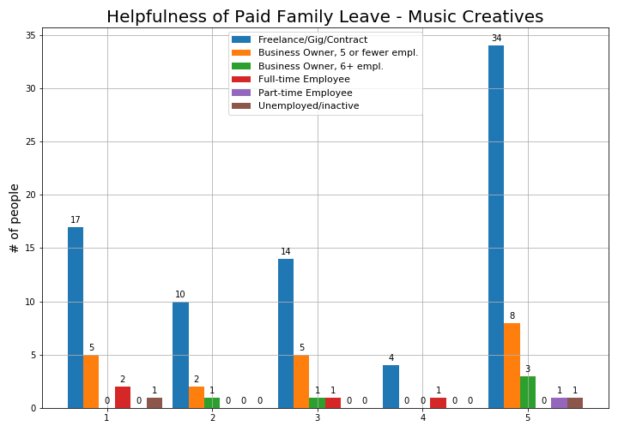
Policy Improvements
1 – Absolutely Critical
5 – Not Helpful at all
This slide and the next three slides show how respondents in the “Music Creatives” occupation felt about policy proposals. As you will see in the next several slides, there is some ambiguity in how the respondents rated their opinions. Up above in blue, if this data is to be believed, there were more Freelance/Gig workers who said that Paid Sick Leave wouldn’t be helpful at all than those who said it would be. I am speculating -- perhaps they are thinking to themselves, “I’m not an employee, so it’s not like I qualify for paid sick leave anyway.” Similarly, maybe people with that mindset answered #3 to just be neutral.
Some of these charts, however, do have an overall downward trend that is more intuitive.
Notes:
This is all over the place, just like the data for Austin was. Unemployment seems to make sense intuitively, but the others are so balanced that it’s kind of surprising. If you take the bars colored blue, which represent the freelance/gig category, maybe there was some subjectivity in how they interpreted the question. Maybe some of them thought, “Well I’m not an employee anywhere, and paid sick leave or family leave isn’t something I qualify for anyway and isn’t helpful to me, so I’m going to put a #5 for unhelpful.” Or maybe they had the same thought process but decided to put #3 and be neutral, since it WOULD be helpful if they were employees but they’re not. That’s my speculation.

Slide 17
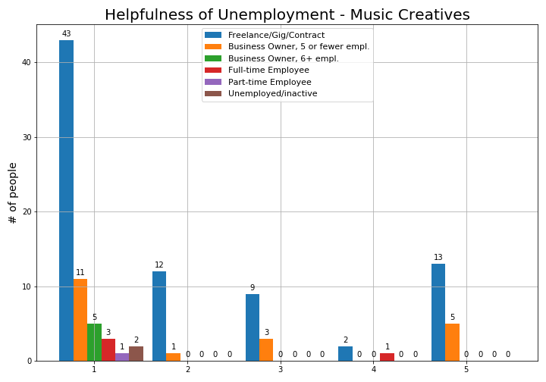
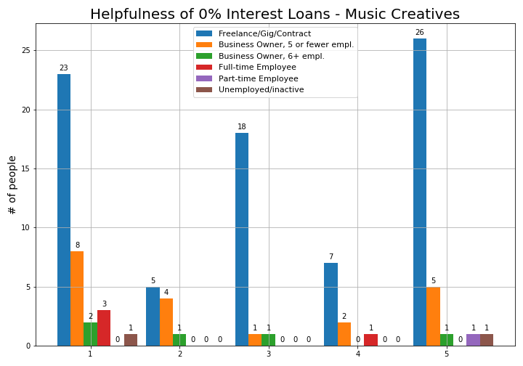
Policy Improvements
Unemployment seems to have that broad downward trend from 1 - 5 that you would expect. Clearly, most people would find unemployment income to be helpful.
However, the helpfulness of 0% interest loans is just as unclear as the charts on the previous slide.
Notes:
This is all over the place, just like the data for Austin was. Unemployment seems to make sense intuitively, but the others are so balanced that it’s kind of surprising. If you take the bars colored blue, which represent the freelance/gig category, maybe there was some subjetivity in how they interpretted the question. Maybe some of them thought, “Well I’m not an employee anywhere, and paid sick leave or family leave isn’t something I qualify for anyway and isn’t helpful to me, so I’m going to put a #5 for unhelpful.” Or maybe they had the same thought process but decided to put #3 and be neutral, since it WOULD be helpful if they were employees but they’re not. That’s my speculation.

Slide 18
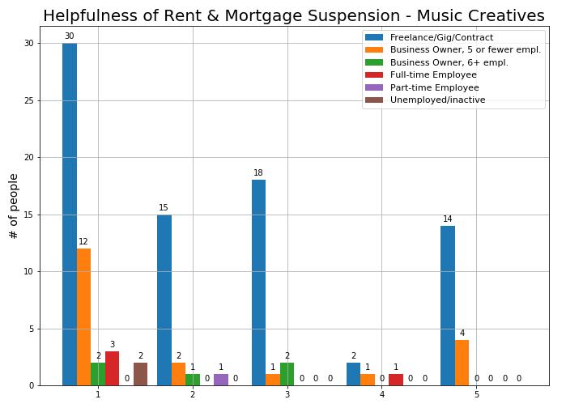
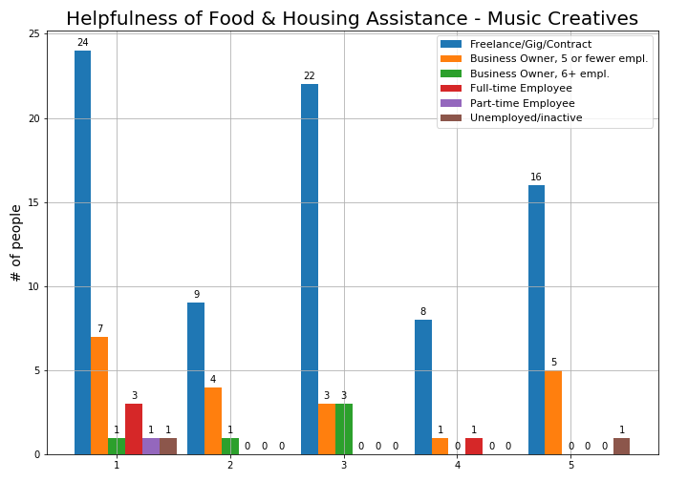
Policy
Improvements
Helpfulness of rent/mortgage suspension seems intuitive for all categories except Freelance/Gig workers (in blue). Speculation -- some music artists live with family or friends and don’t pay rent. The same can be said for Food & Housing on the right chart. I can’t imagine why they would say that assistance with food wouldn’t be helpful, unless they already have their food being covered for them.

Slide 19
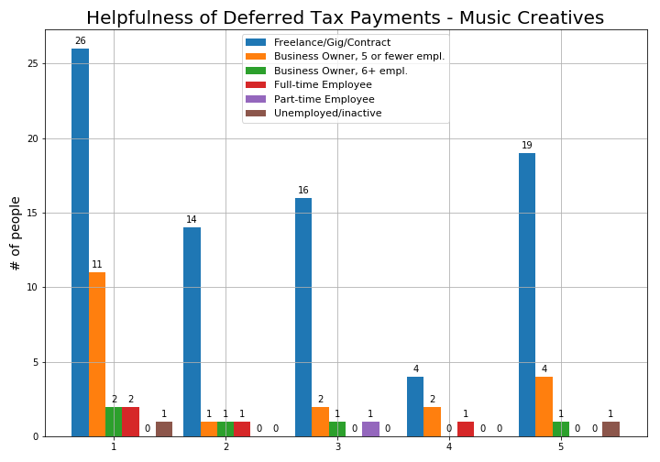
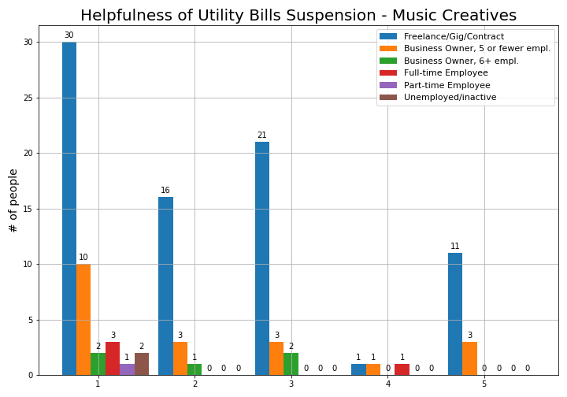
Policy Improvements
Something else to note, in addition to the feedback I’ve shared in the last few slides, is that almost 72% of Music Creatives are in the “Freelance/Gig/Contract worker” category. Even though the downward trend of all the other categories in these charts seems to make more sense than the blue bars for Freelancers, we cannot know for certain that they wouldn’t look entirely different if we had more data. All we can tell you is what this current data shows us.

Slide 20
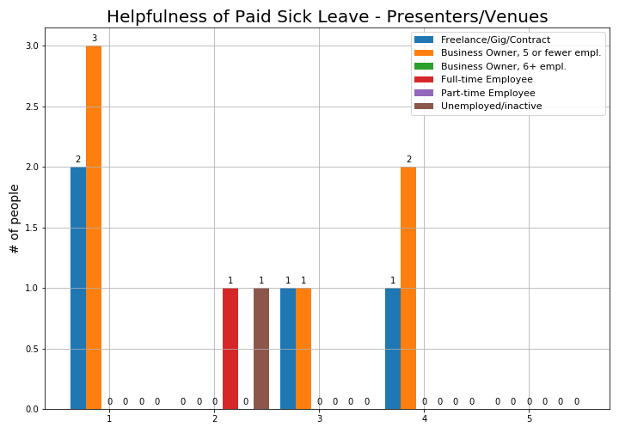
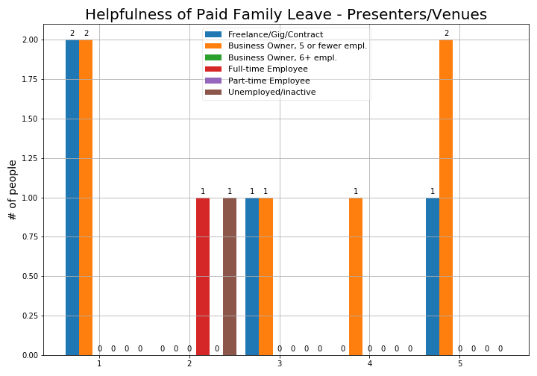
Policy Improvements
This slide and the next three slides are for the Presenters/Venues occupation.
The caveat with these slides is that there were only 12 survey respondents in North Carolina who identified themselves in this occupation. Unfortunately that is nowhere near enough to make valuable insights or offer meaningful recommendations, but I made charts with the responses anyway just like for the Music Creatives. There’s not much else that I can say about them. The overall downward trend that you would expect is more apparent for the 12 people in this occupation than it was in the last four slides’ charts.

Slide 21
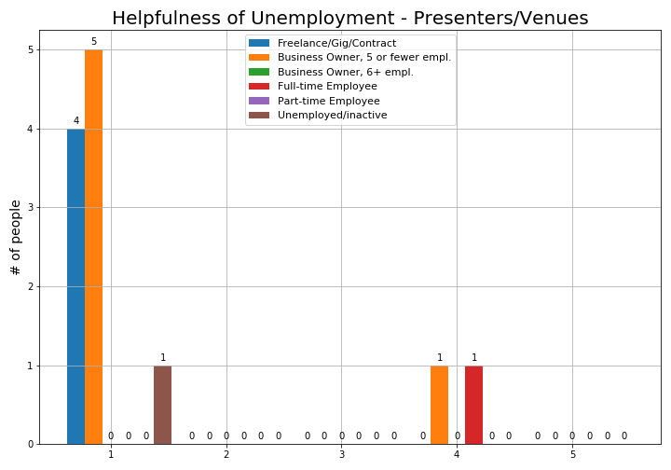
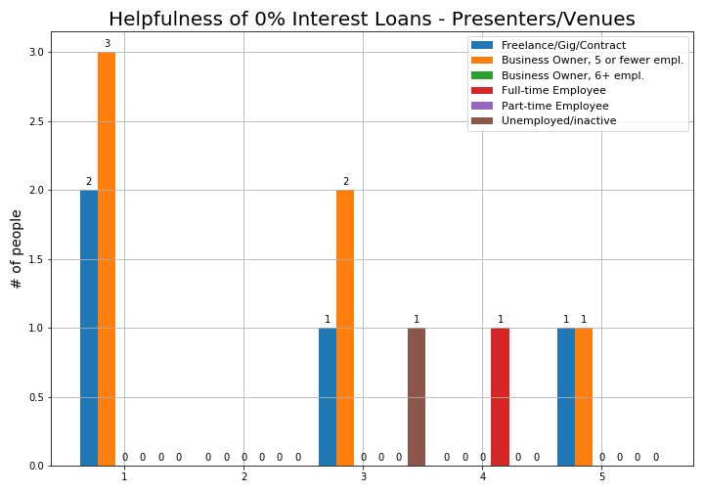
Policy Improvements

Slide 22
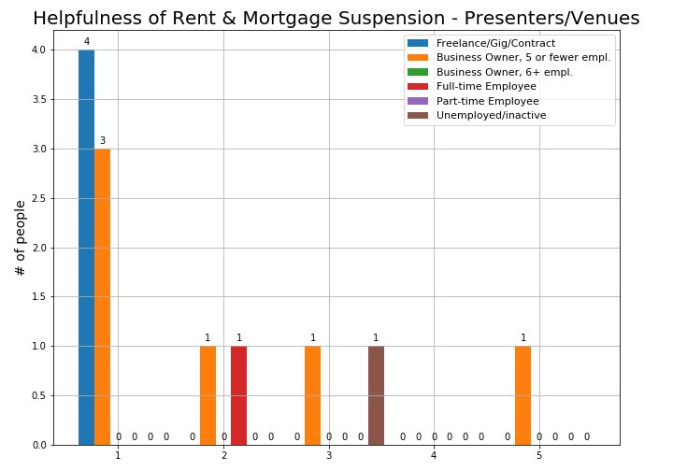
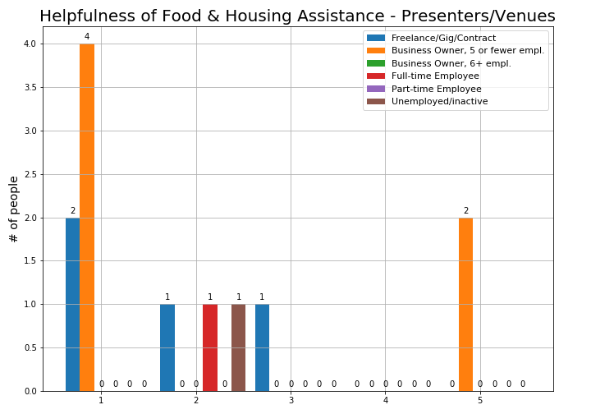
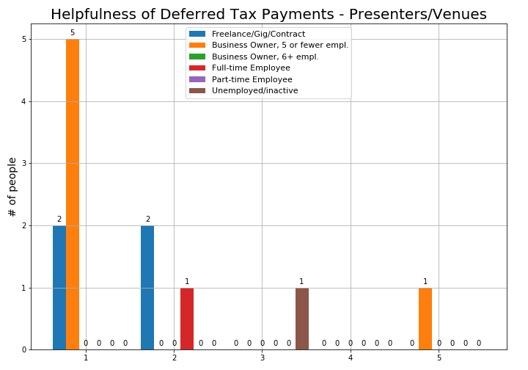
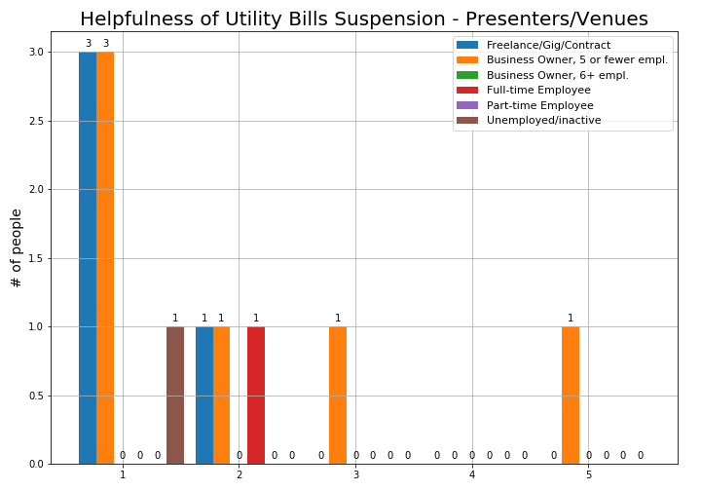
Policy Improvements

Slide 23
Feedback: Common Themes
44 responses => small
Thank you! (lots)
Feeling of Loss: “scared”, “fucked”, etc.
Navigating Grants/Unemployment Support
Feel like all the programs ‘tapped out’
Lots of denials in unemployment benefits
Mental Health
Specifically how to be productive while depressed
Community
“Include Photographers!”
Union
Learning - ex. Tech, How to get into streaming, etc.
Notes:
Theme: Thank you!
Theme: Grants:
Most of the money goes to the performers, not the production side. If money was pushed into a production studio, performers can digitize their music and make money off that.
“Too Complicated
“We need Rent Control in Austin. Too many venues are closing”
"Grants and unemployment benefits are nice but ultimately not sustainable. I thoroughly believe no one really cares about or values production workers, most especially musicians, and many industry workers will transition into new industries because of this."
"the COA has not provided any relief to landlords regarding decreasing property taxes or providing credits to landlords that do continue to rent to non-paying tenants. Landlords are painted as evil, but they have bills and mortgages and taxes too."
Texas unemployment has been impossible. The website tells you to call. The number you call tells you to go the website. Absolutely useless.
Theme: Health Care
Common theme: DEPRESSION
“The emotional toll on me due to financial difficulties coupled with loss of performance opportunities in order to blow off steam and exorcise the terrible feelings of worthlessness has been the worst part of this pandemic.”
“A community that provides coaches who offer gentle accountability, feedback (not opinions), emotional and professional intelligence. Something as simple as Akimbo.com workshops, but more catered to music professionals and emerging creative professionals. I need a place to connect that is not Facebook.”
Theme: Community
Where is networking? In non-track career, how do i navigate? Several people have “if i can just play there, then we can make it” attitudes. Where is the place?
Booking begets more booking, I was booked because people saw me. No one is seeing me. Am I ever going to get booked?
Theme: Distrust of the Government
Still unpaid unemployment and sbl’s
"independent contractors are treated as non entities by the government, the banks, the state and lenders.... even with 30 years of income documentation no one likes a person withotu a paycheck.
"Germany set aside $50 billion for artists in their stimulus. US stimulus gave only 300 million to Nat. Endowment for the Arts. That says it all. Kennedy Center received 25m and then fired all their musicians. Everyone will say when this is over how Spotify, Netflix, Amazon Prime, Live-streams, etc got them through the crisis. Then artists/musicians will once again hear how non-essential we are. There needs to be a voice to advocate for ARTISTS/MUSICIANS in government. I very much hope Music Cities Together can be that voice and thanks so much for what your organization is doing. "
“The government is throwing money at big-name corporations and providing opportunities for rich people to gobble up assets at bargain-basement prices all the while giving very little to the people who are most affected and could use it most.”
Theme: HUMANITY considered: being lost in a statistic
I spoke on these topics at the Austin Music Commission Meeting on Monday, March 3, 2020 under item 2C (4:13 - end of video ~21:33). The link to the whole video is: http://austintx.swagit.com/play/03022020-985. I implore you to listen to and consider me.
Kids:
“100% loss of contracted gigs. It hurts on many levels. With young kids at home it is exponentially more difficult.”
Theme: Totality.
"Austin would not be the money making tourist attraction it is without musicians, artists, promoters, venues etc.. Protecting this ecosystem in turn strengthens our economy. "
"It’d be nice for city of Austin to help us, we contribute a lot to the city and bring people to town who then spend a lot of money"
Theme: Normalcy
When things return back to normal, it will be at lower capacity, thereon higher competition => lower wages.

Slide 24
Thoughts for Future Survey
Given more survey respondents and data, would there be identifiable trends among other, less common, occupations in the industry?
What about for other regions besides the big ones like Austin and North Carolina?
Would there be a significant difference in responses from those with health insurance vs those without?
With 1 - 5 being re-labeled as “Not helpful” to “Most critical,” would we see a change in respondents’ thoughts about the helpfulness of certain resources and policies?
Change the “City” selection to be a drop-down menu (with “Other” as an option), because apparently there are a million ways to spell every city.
For secondary income, make a drop-down option for, “I have a second job in a different industry.”
For respondents who took the survey more recently and said they are working full-time - have they been working full-time all year long, or were they let go and then re-hired?
If a survey like this were to be sent out later this year, many questions like this one would need to be modified to inquire about changes that have occured over time.

